Slide 1




Tract-analysis and connectivity
Eleftherios Garyfallidis, PhD
Diffusion Imaging in Python
http://dipy.org
Sherbrooke Connectivity Imaging
Laboratory http://scil.dinf.usherbrooke.ca
Research Centre on Aging
http://cdrv.csss-iugs.ca

Slide 2

Declaration of financial interests or relationships
Speaker name: Eleftherios Garyfallidis
I have no financial interests or relationships to disclose with regard to the subject matter of this presentation

Slide 3
Table of contents
Top-down
Connectomics and known issues
2. Tract-analysis and it’s potential
Bottom-up

Slide 4
Structural Connectomics

Slide 5
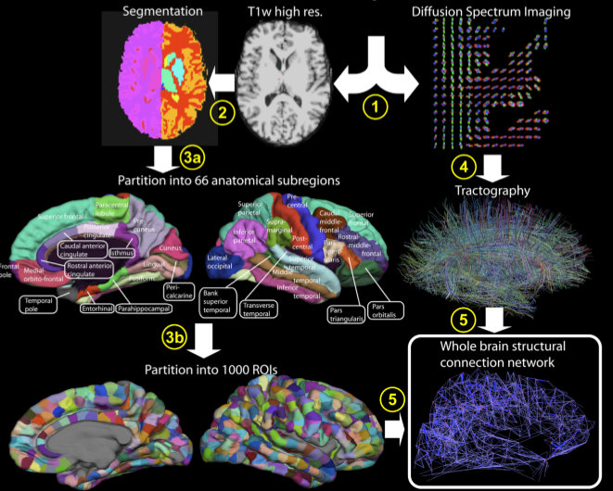

Connectomics
Hagmann et al. PLOS Biology 2008
Tract-analysis and connectivity - Eleftherios Garyfallidis (2015)

Slide 6
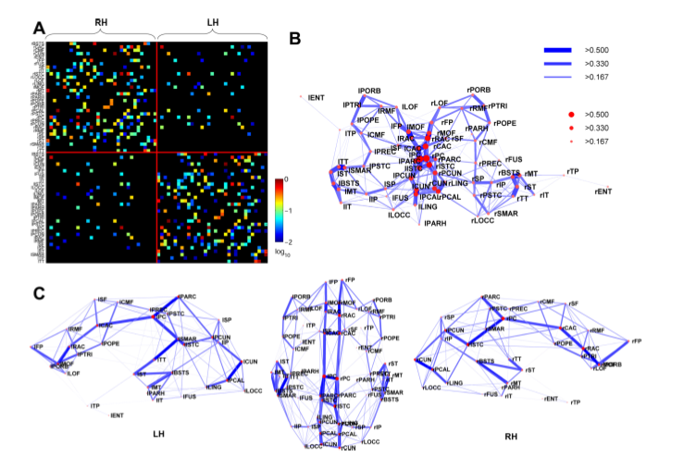
Connectivity matrices
Hagmann et al. PloS Biology 2008
Hagmann et al. PloS Biology 2008
Tract-analysis and connectivity - Eleftherios Garyfallidis (2015)

Slide 7
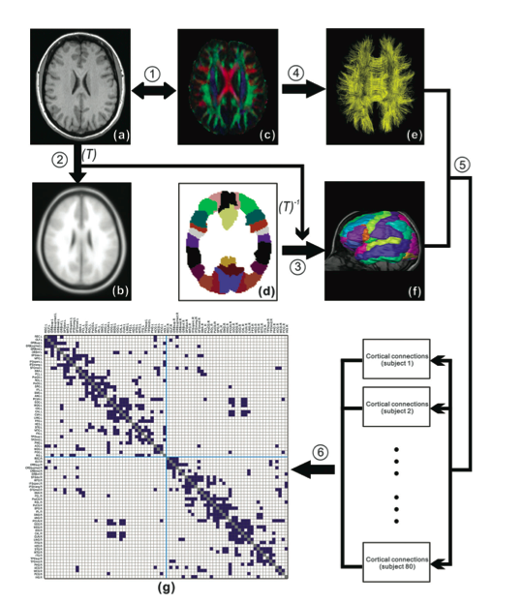
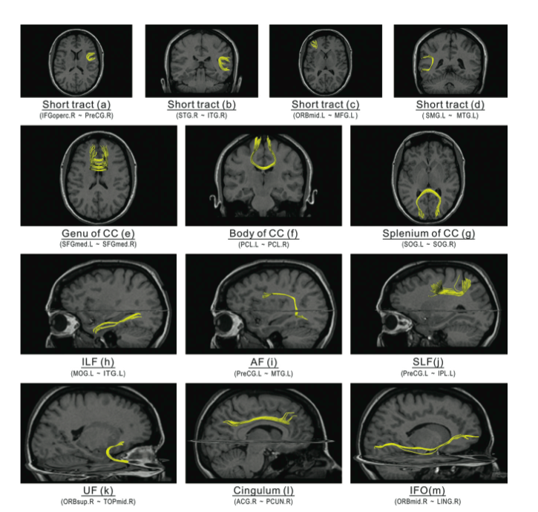
Can we validate the underlying anatomy?
Cortical regions may split or merge real bundles
Difficult to check all tract combinations
Alignments with T1 need to be excellent
Cortical regions may vary between subjects
Gong et al. Cereb. Cortex 2009
Tract-analysis and connectivity - Eleftherios Garyfallidis (2015)

Slide 8
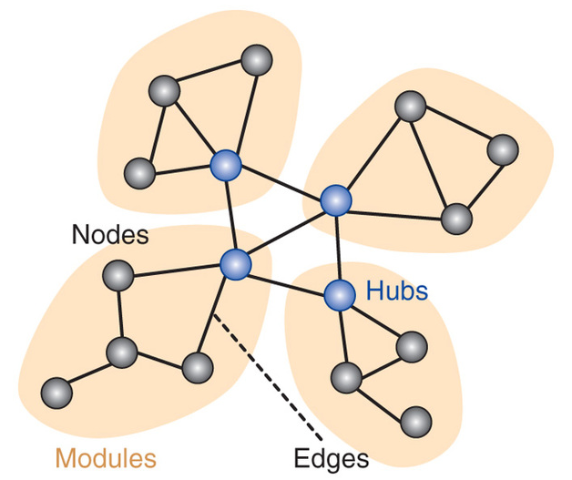
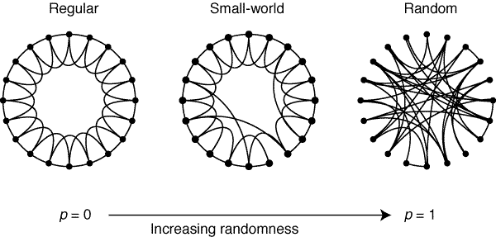
Graph theory is powerful
As it provides a mathematically sound framework
to study networks.
But it needs good input …
Make sure when you compare different populations that all the preprocessing steps before the matrices are very well done.
Look at the connectomics and then go back and look into the actual bundles. More info next …
Tract-analysis and connectivity - Eleftherios Garyfallidis (2015)

Slide 9
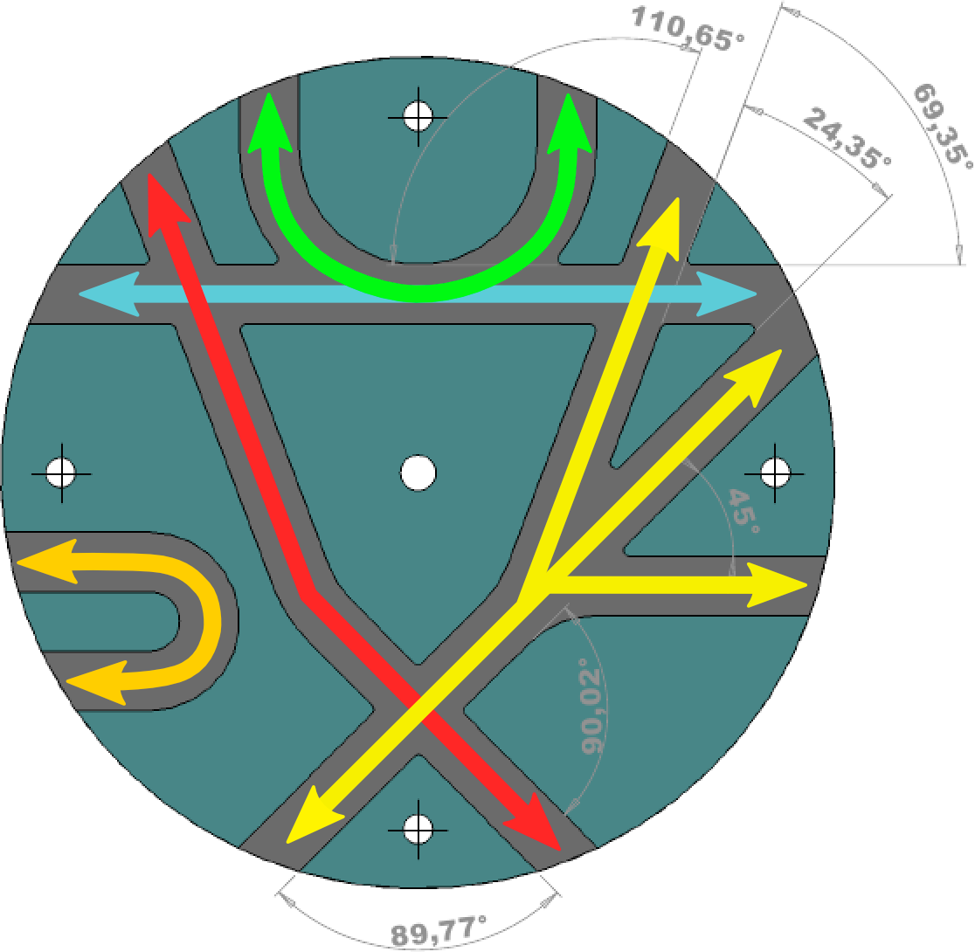
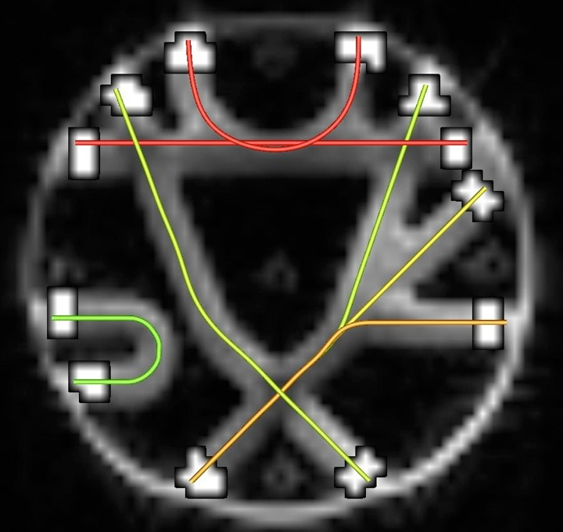
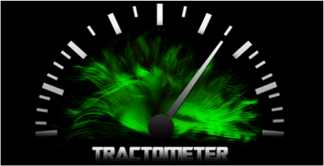
Connectivity analysis (the good guys)
Valid connections and valid paths
Fiber Cup Phantom
Fillard et al. NeuroImage 2010
Connecting regions of interest (ROIs)
Marc-Alex Côté, Neuroimage 2013
Tract-analysis and connectivity - Eleftherios Garyfallidis (2015)

Slide 10
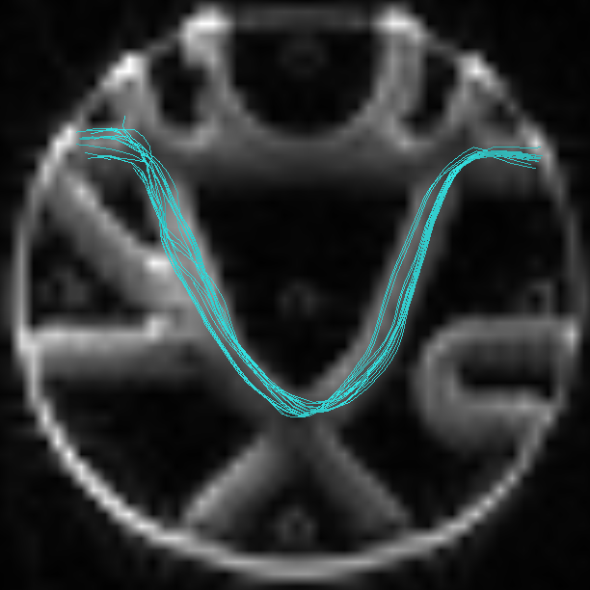
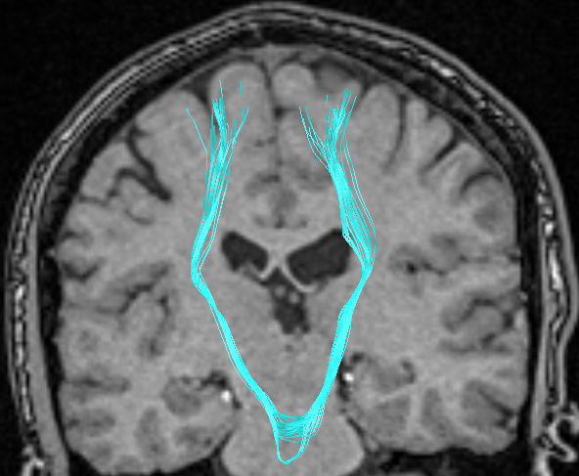
Connectivity analysis (bad guys)
Valid connections but wrong path
Tract-analysis and connectivity - Eleftherios Garyfallidis (2015)

Slide 11
Connectivity analysis (more bad guys)
Invalid connections – connects two regions that shouldn’t be connected
Tract-analysis and connectivity - Eleftherios Garyfallidis (2015)

Slide 12
Connectivity analysis (and the ugly)
Does not connect two end regions – stops prematurely in ventricles or mask
Tract-analysis and connectivity - Eleftherios Garyfallidis (2015)

Slide 13
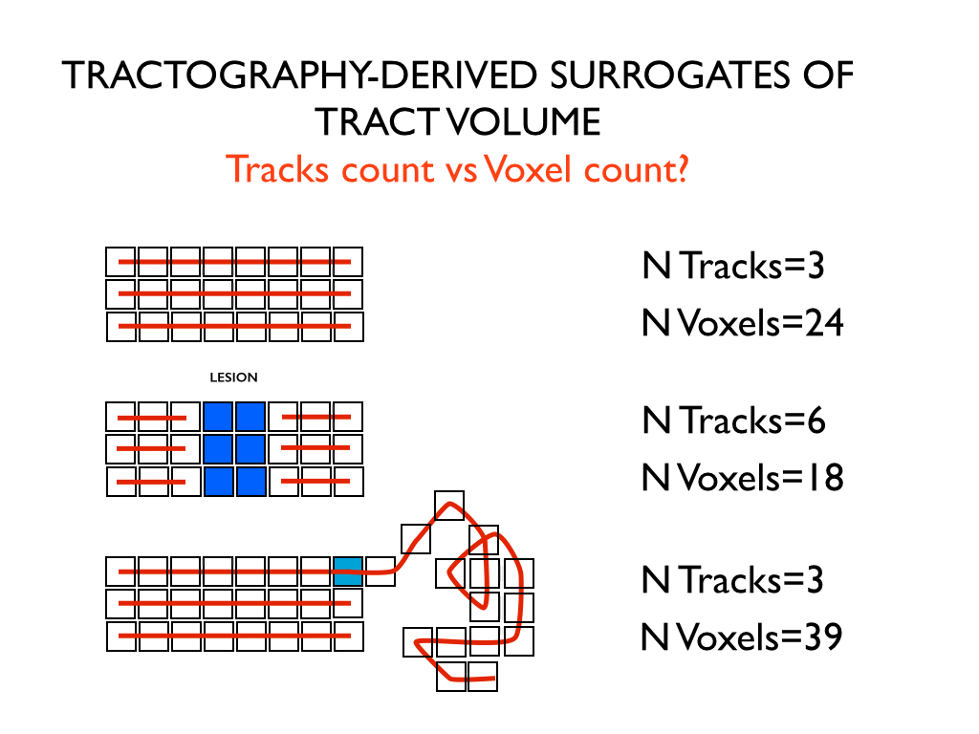
Alert for connectivity analysis! Be critical when counting streamlines
Courtesy of Marco Catani
Tract-analysis and connectivity - Eleftherios Garyfallidis (2015)

Slide 14
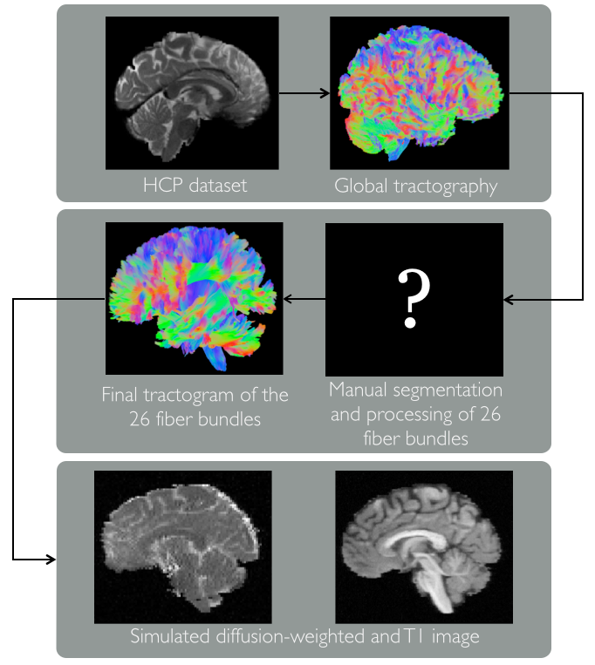
Lesson learned from the ISMRM 2015 tractography challenge: Use the streamlines!
Voxel perfect alignment with the
T1 is absolutely necessary.
Motion can push your connectivity
results massively.
Counting streamlines going through
ROIs is very sensitive even with a phantom.
Solution! Use model bundles to measure your
connectivity and validate the participants.
Now valid connections are the bundles which are
close to the model bundle up to a distance threshold.
This technique does not require voxel perfect
alignment and can deal with small warps.
But let’s be clear…
Details at tractometer.org
Tract-analysis and connectivity - Eleftherios Garyfallidis (2015)

Slide 15
Tract-analysis

Slide 16
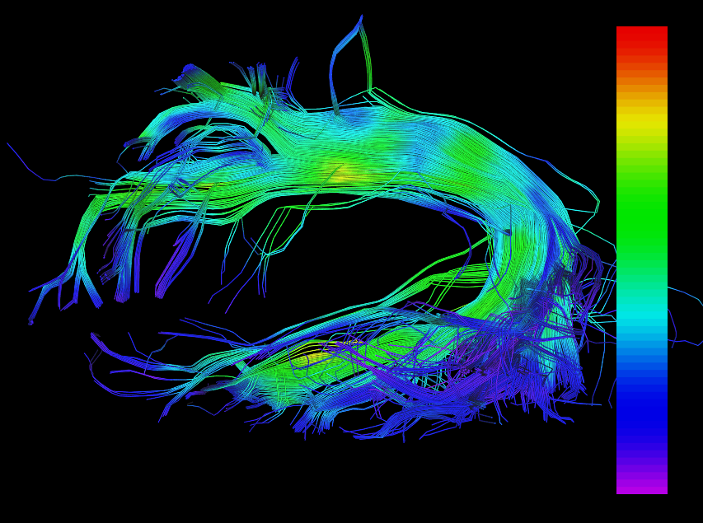
What is tract-analysis?
A tract is one of brain’s
superhighways
known from anatomy
A bundle is an
approximation of a tract
using a set of streamlines
Metrics/Maps
FA, AFD, MD etc.
Scalar or Vector.
Tract-analysis is all about bundle-maps.
In this talk I will focus more on the streamlines rather than on the maps.
By interpolating the metric values on the points of the streamlines we can start talking about bundle integrity and looking into pathology.
The shape of the bundle itself gives also information about the underlying pathology. An example is with the language pathways in autistic populations¹.
[1] Lewis et al., Cerebral Cortex, 2013.
Tract-analysis and connectivity - Eleftherios Garyfallidis (2015)

Slide 17
Streamlines and images a technical note
(x, y, z)
(i, j, k)
Streamlines are 3D curves (a series of line segments) where their points are in floating point coordinates (x=10.3, y=10.5, z=1.8).
This is in contrast to the image coordinates which are integer coordinates (i=10, j=11, k=2).
Common file formats for streamlines are Trackvis (*.trk), VTK, *.tck.
Common file format for metrics is NIfTI (*.nii.gz, *.nii)
More than often a bottleneck in tract-analysis is dealing with the file formats.
Familiarize yourself with the different coordinate systems. See Matthew Brett’s
tutorial on the topic http://nipy.org/nibabel/coordinate_systems.html.
I recommend Nibabel for reading both NIfTI and Trackvis files.
Soon with conversion/correction capabilities for streamline formats.
Tract-analysis and connectivity - Eleftherios Garyfallidis (2015)

Slide 18
Why streamlines are useful?
20
2
1
They integrate information along many voxels
They contain connectivity information (sequential)
They can tell us about shape and orientation
Together with other streamlines make “good” models of bundles. Better than using surfaces or just points.
20
The order of the points between two
streamlines can be the reverse even in the
same bundle.
2
1
1
19
20
Many points… computational expensive and heavy on memory.
To compare streamlines you need to define a distance between streamlines.
Tract-analysis and connectivity - Eleftherios Garyfallidis (2015)

Slide 19
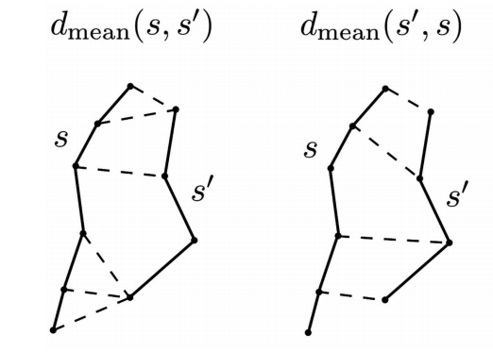
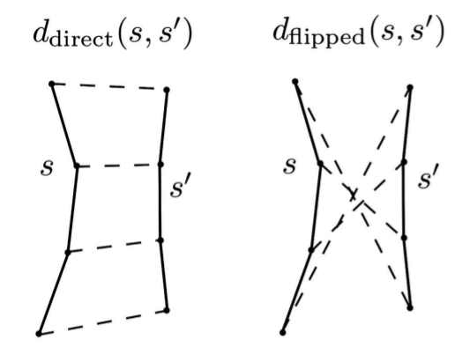
Streamline distances – which one to use ?
Haussdorff distances¹
Computationally expensive
Can put together streamlines of different length.
Streamlines can have different numbers of points
[1] Corouge et al. ISMRM 2004
Vector-like distances^{2,3}
Points are now arrays of
fixed size.
Separate streamlines of
different length.
Very efficient.
[2] Garyfallidis et al. HBM 2010
[3] Guevara et al. HBM 2010
Tract-analysis and connectivity - Eleftherios Garyfallidis (2015)

Slide 20
Streamline distances – which one to use ?
Minimum Direct Flipped (MDF) distance
Garyfallidis et al., Frontiers 2012
min(ddirect, dflipped)
Fast to compute
Symmetric
Metric distance
Values from 0 to Inf in millimetres
Interpolation along the length is necessary
with fixed number of points. Recommended numbers
are from 12 to 20.
Lower MDF
Higher MDF
Tract-analysis and connectivity - Eleftherios Garyfallidis (2015)

Slide 21
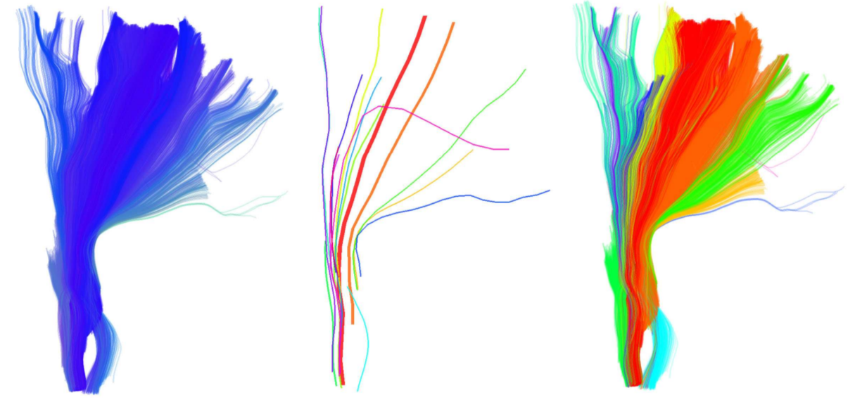
QuickBundles for Simplification
Using Minimum Direct Flipped (MDF) and
the QuickBundles¹ clustering algorithm
Very fast
Single distance threshold (mm)
Works with millions of streamlines.
initial
centroids
clusters
This is unsupervised learning. Do not expect to get anatomically relevant clusters as a neuroanatomist would define them. Especially in the case of a whole brain tractography.
For anatomically relevant bundles you need to use supervised learning i.e. have a model of a bundle.
Earlier work on clustering of streamlines^{2,3}.
[1] Garyfallidis et al., Frontiers 2012
[2] Guevara et al., Neuroimage 2010
[3] O’Donnell et al., IEEE TMI 2008
Tract-analysis and connectivity - Eleftherios Garyfallidis (2015)

Slide 22
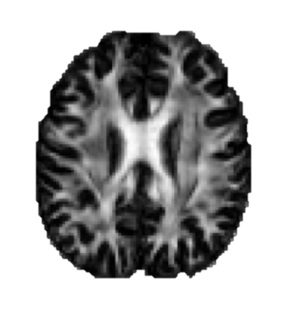
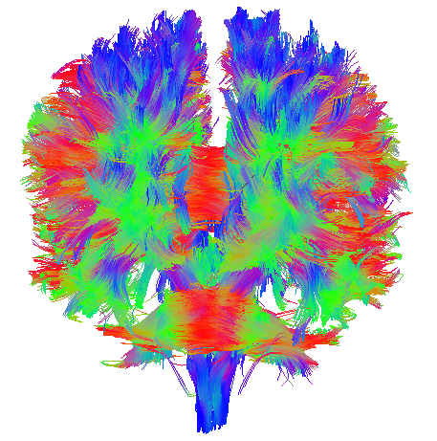
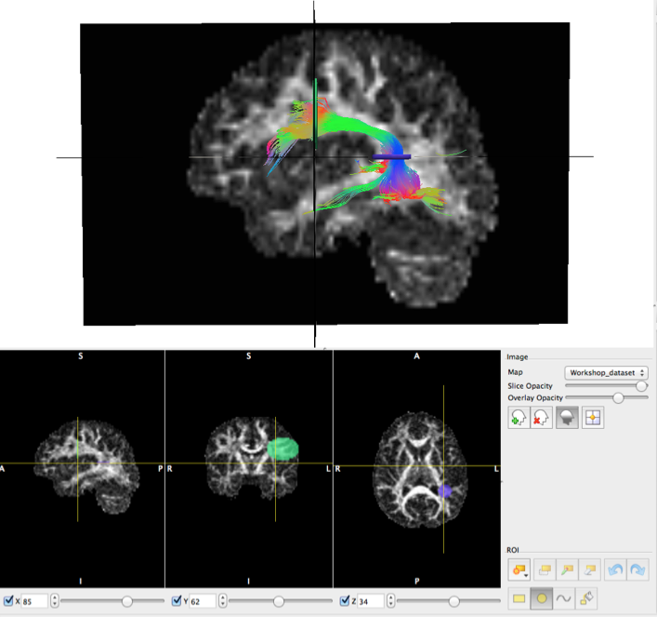
Manual segmentation
Types of ROIs:
Inclusion (logical “and” and “or”)
Exclusion (logical “not”)
How we use ROIs:
Termination Points (e.g. Cortical)
Waypoints (e.g. specific white matter region)
Volumetric (e.g. U-Shape)
Courtesy of Flavio Dell’ Acqua
Available visualization tools:
Trackvis, Fibernavigator and MI-Brain
Tract-analysis and connectivity - Eleftherios Garyfallidis (2015)

Slide 23
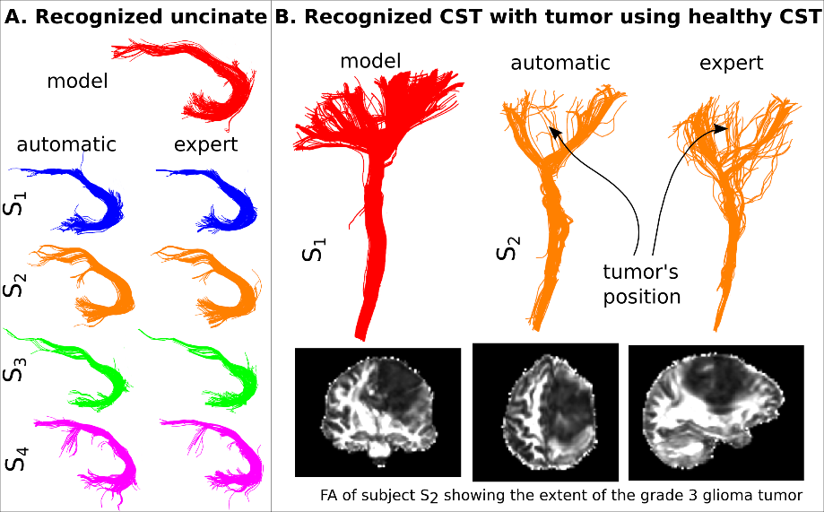

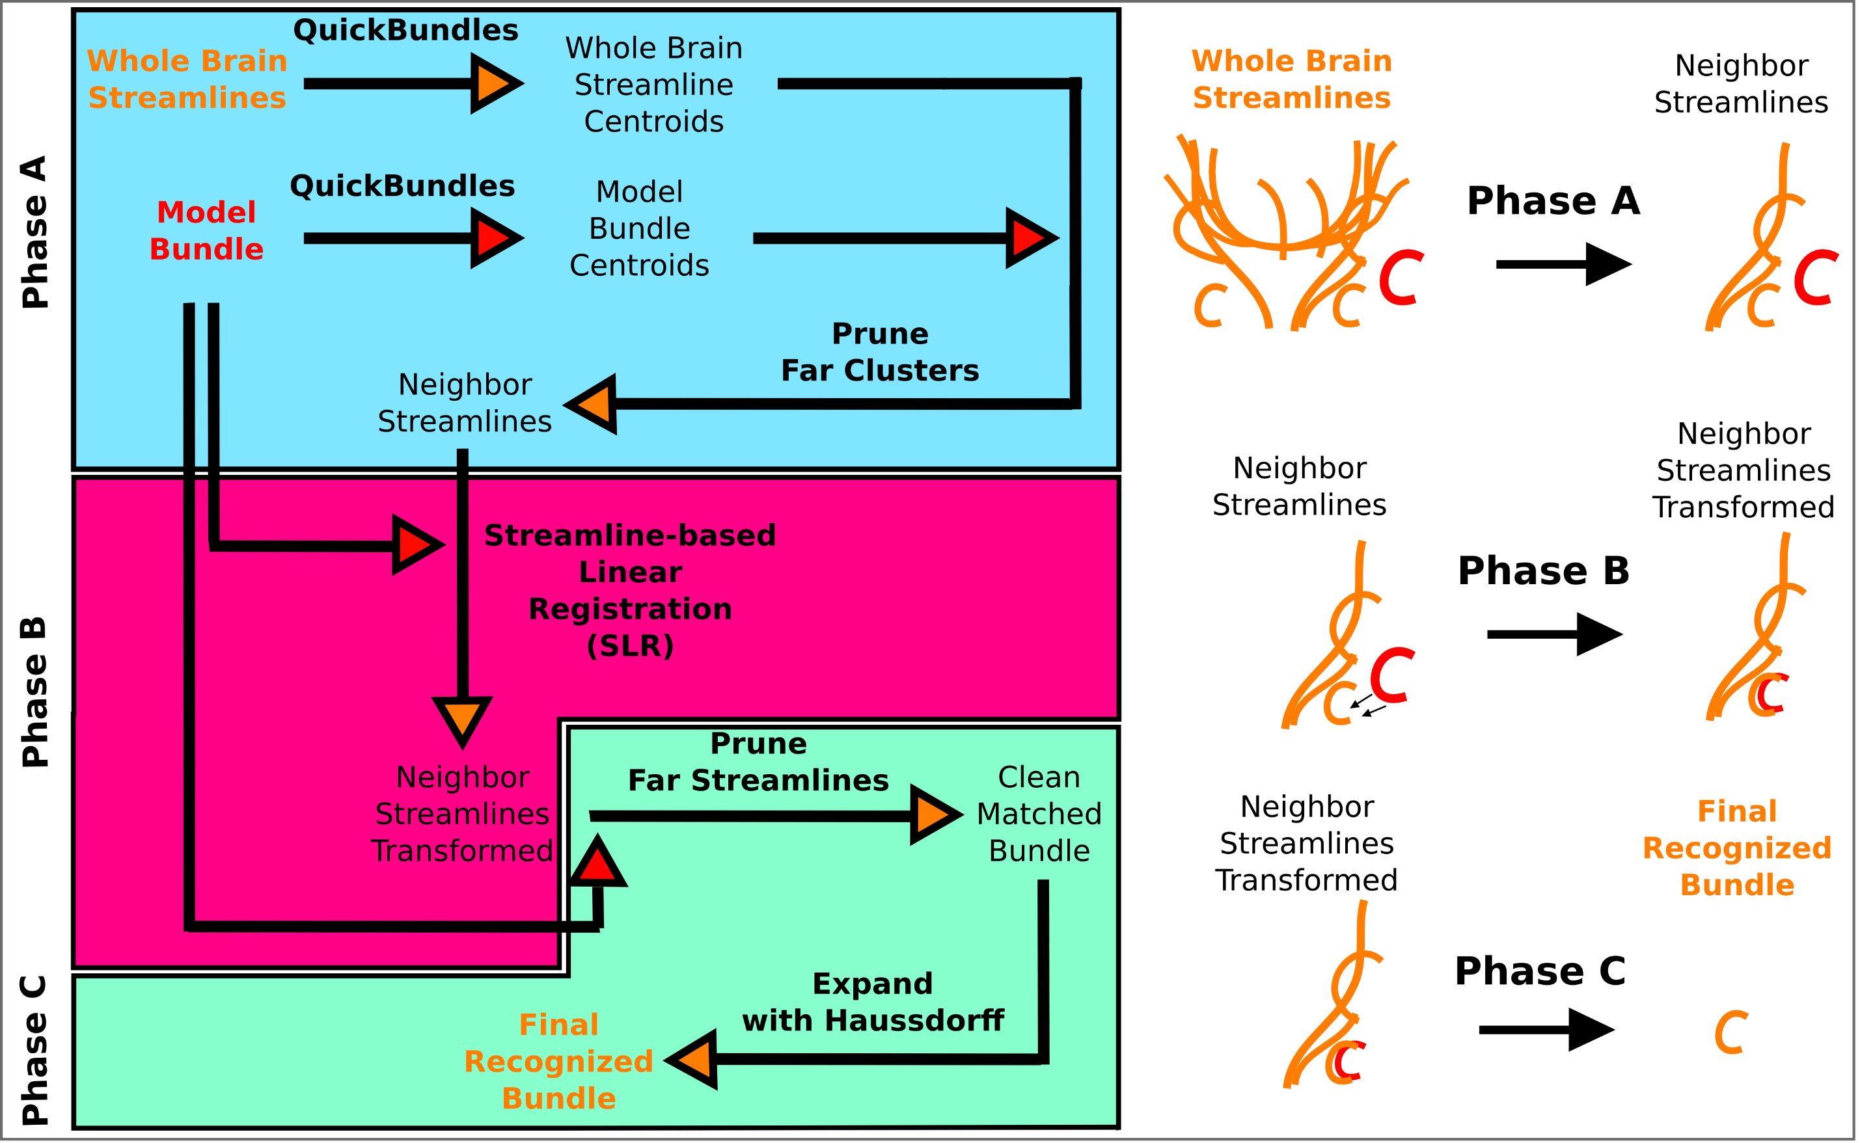
Model-based Segmentation
Garyfallidis et al., Recognition of bundles in healthy and severely diseased brains, ISMRM 2015.
See also Mayer et al., IEEE TMI 2011
Prasad et al., Neuroimage 2014
Tract-analysis and connectivity - Eleftherios Garyfallidis (2015)

Slide 24
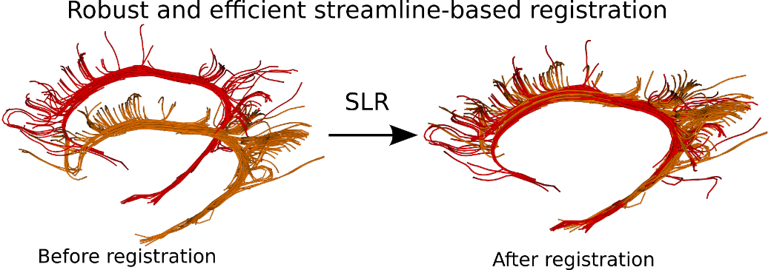
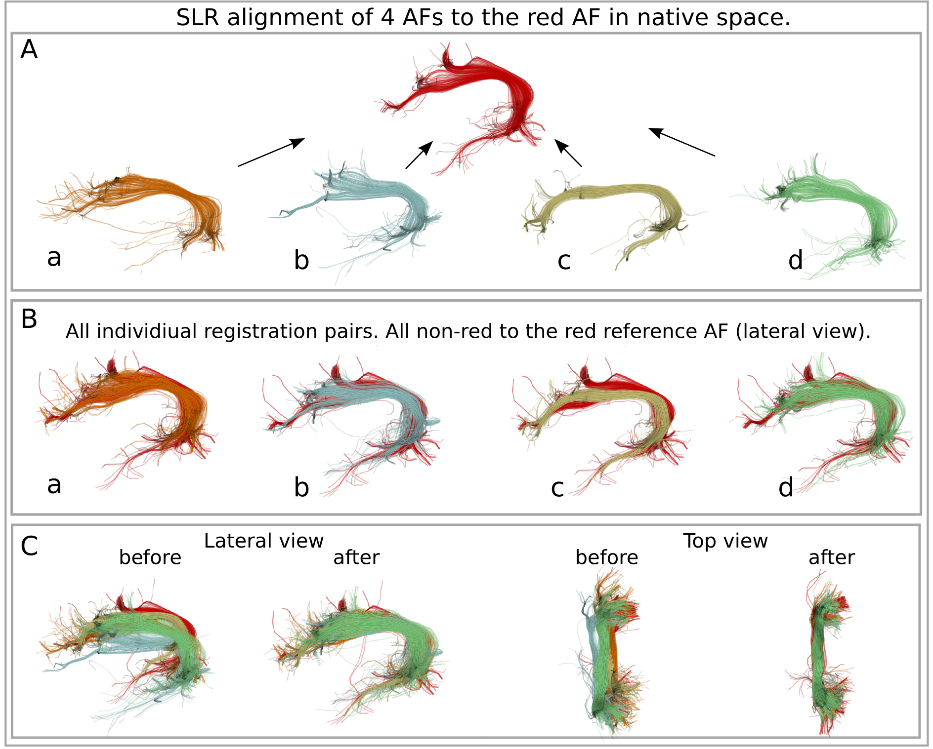
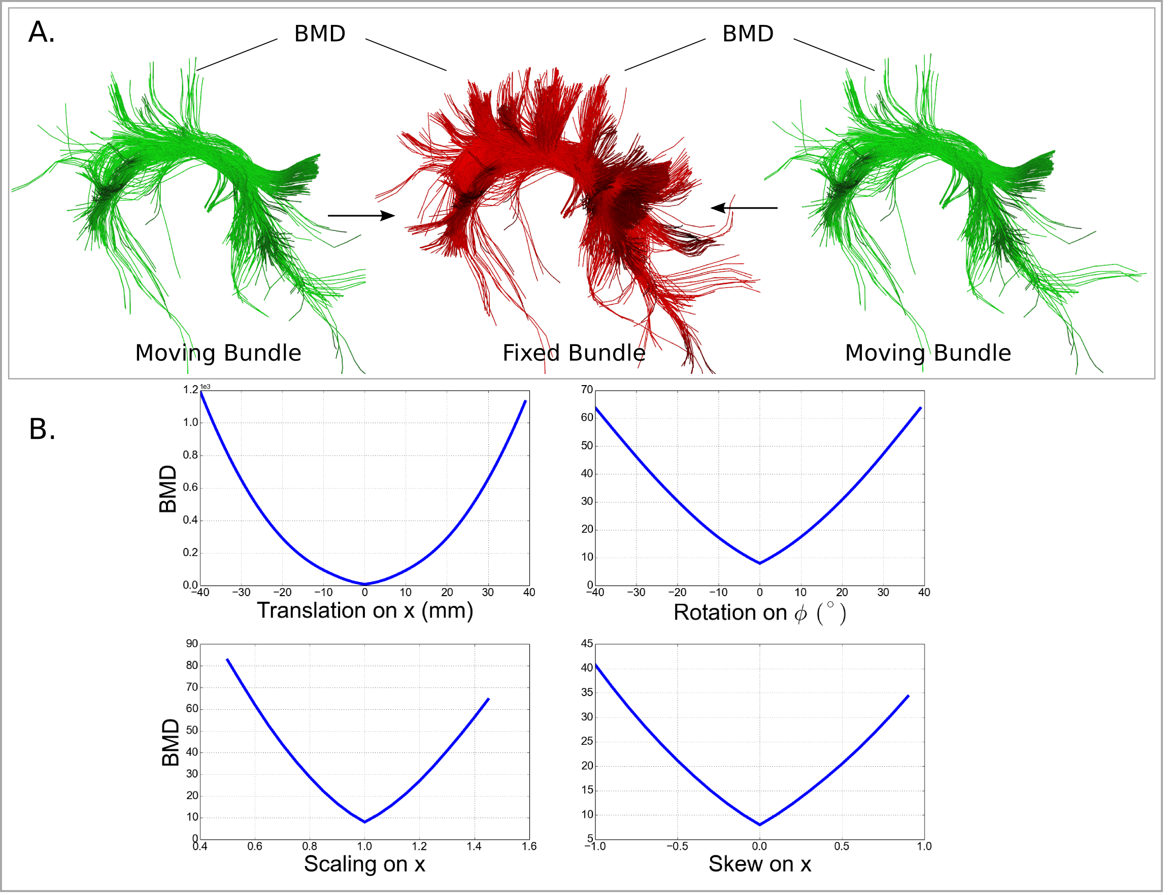
Registration of bundles
The Streamline-based Linear registration (SLR)
is very robust to incomplete data.
Garyfallidis et al. Robust and efficient linear registration of
fascicles in the space of streamlines, Neuroimage (2015)
Tract-analysis and connectivity - Eleftherios Garyfallidis (2015)

Slide 25
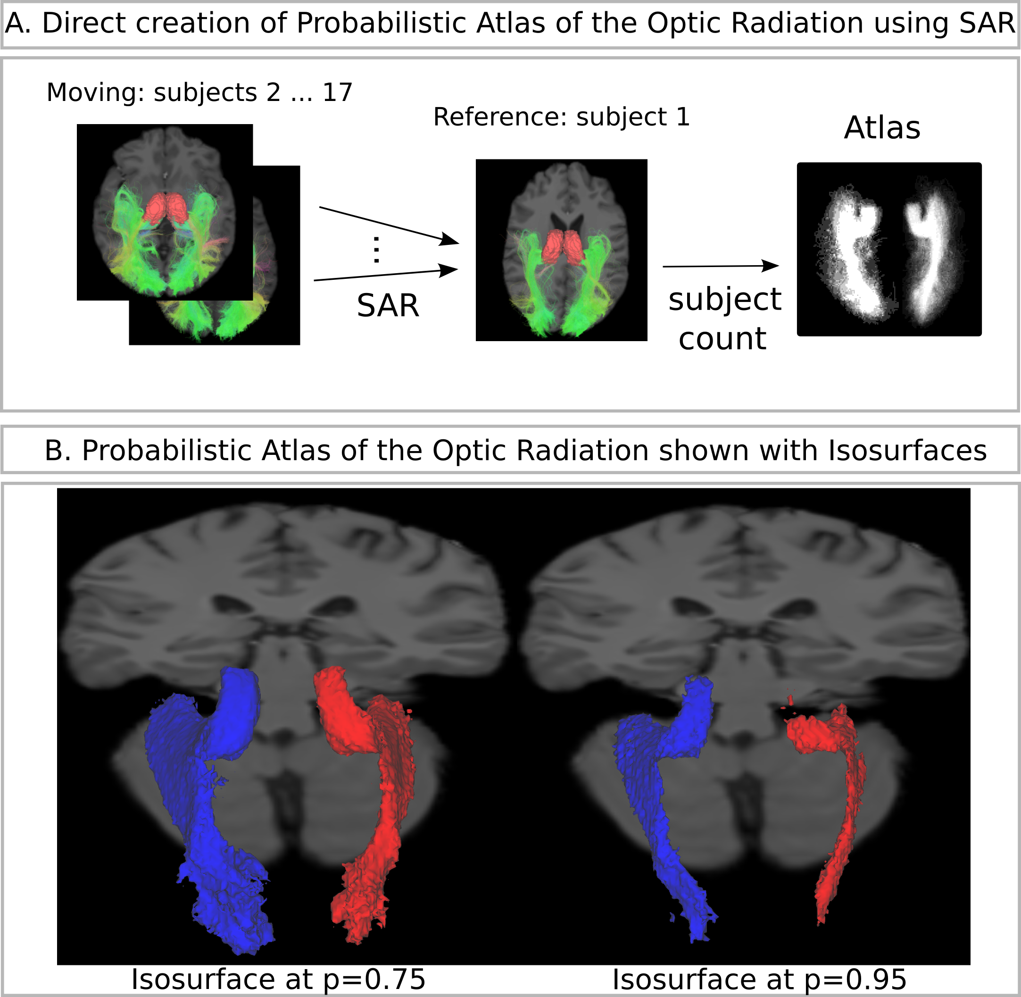
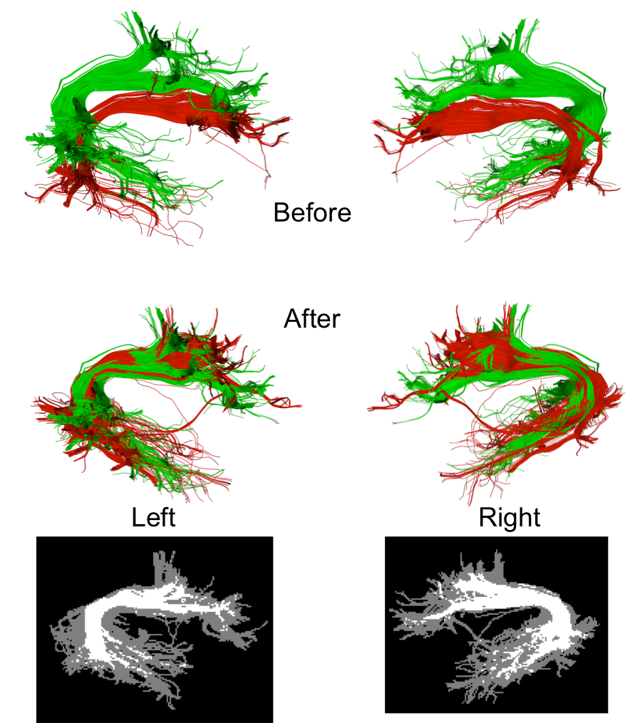
Create bundle-specific atlases using SLR
Find overlaps between bundles
Atlas of the Optic Radiation
Garyfallidis et al., Neuroimage (2015)
Renauld et al., OHBM (2014)
Tract-analysis and connectivity - Eleftherios Garyfallidis (2015)

Slide 26
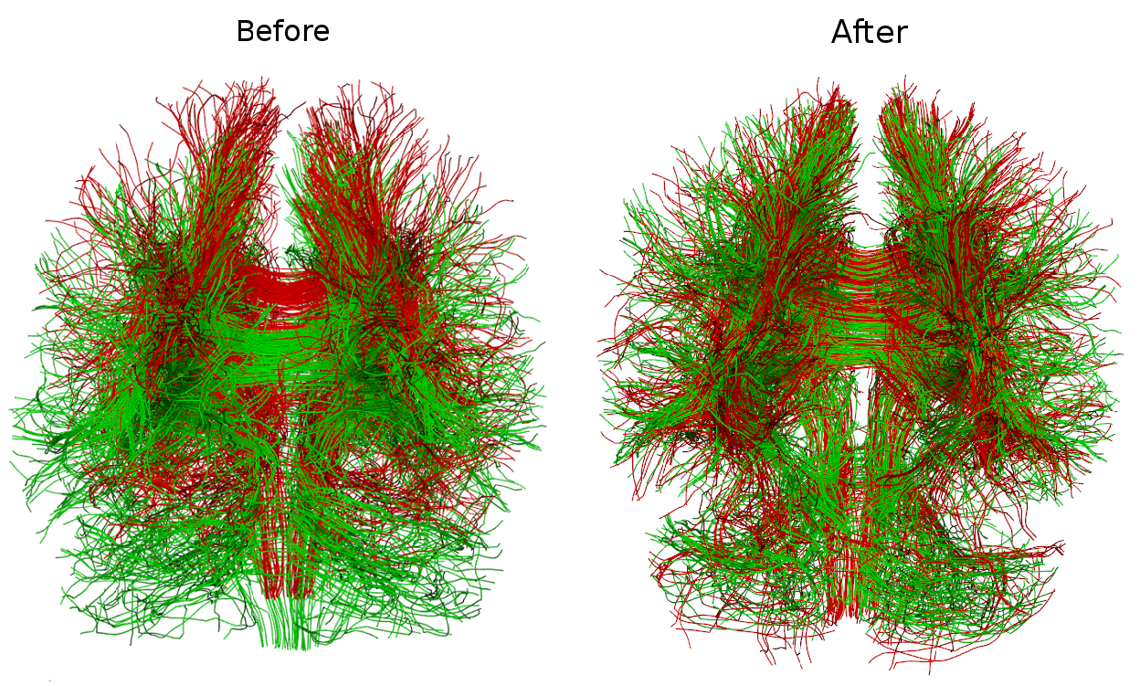
Whole-brain linear registration of streamlines
Garyfallidis et al. Robust and efficient linear registration of
fascicles in the space of streamlines, Neuroimage (2015)
In brains with large tumors even image-based linear registration can fail. Use this method instead. Register the streamlines not the images.
Tract-analysis and connectivity - Eleftherios Garyfallidis (2015)

Slide 27

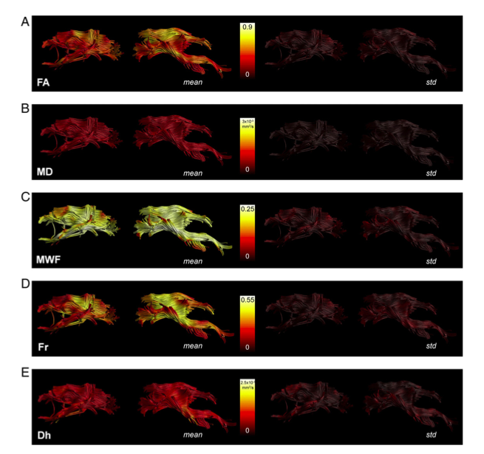
Tractometry
FA₅
FA_{n-1}
FA₄
FA₃
FA₂
FA₁
Bells et al. ISMRM 2012, Assaf et al. Neuroimage 2013,
Catani et al, PNAS 2007, Lebel & Beaulieu HBM 2009, Forkel et al Brain 2014
Courtesy of Flavio Dell’ Acqua
Tract-analysis and connectivity - Eleftherios Garyfallidis (2015)

Slide 28
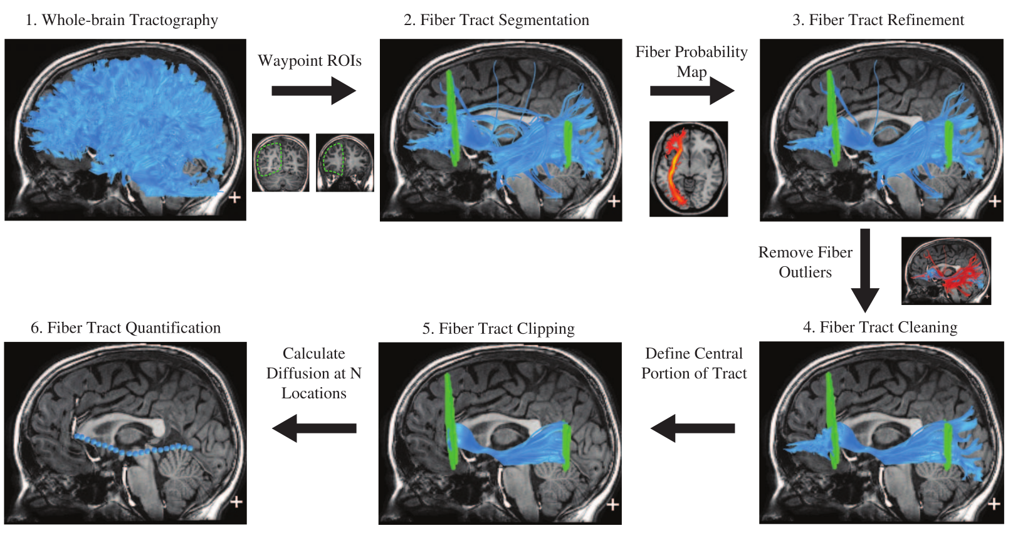
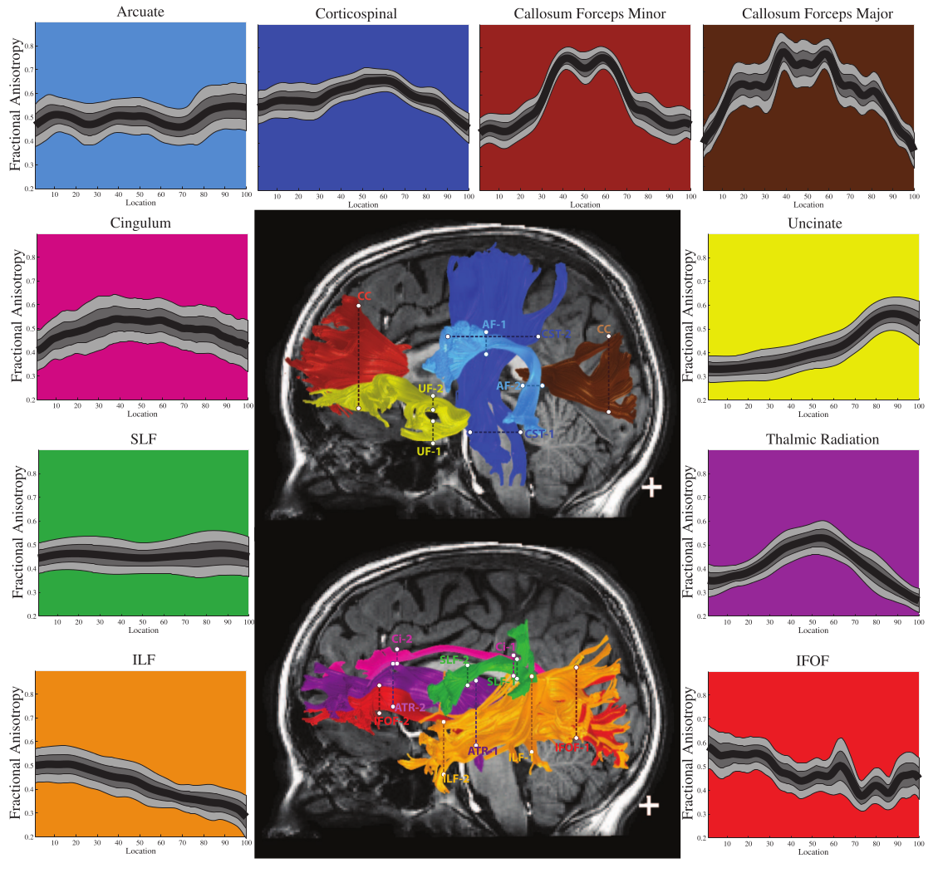
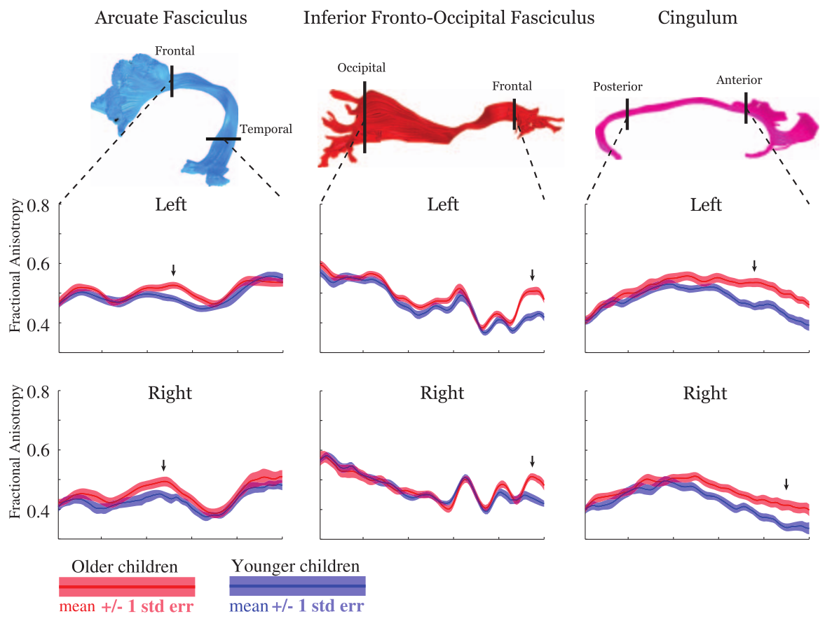
Apparent fiber quantification
Yeatman et al. PLoS 2012
Define planes in MNI space after
registering FA images with nonlinear
registration
Project the planes back in
native space.
Tract-analysis and connectivity - Eleftherios Garyfallidis (2015)

Slide 29
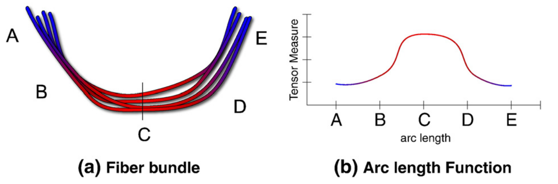
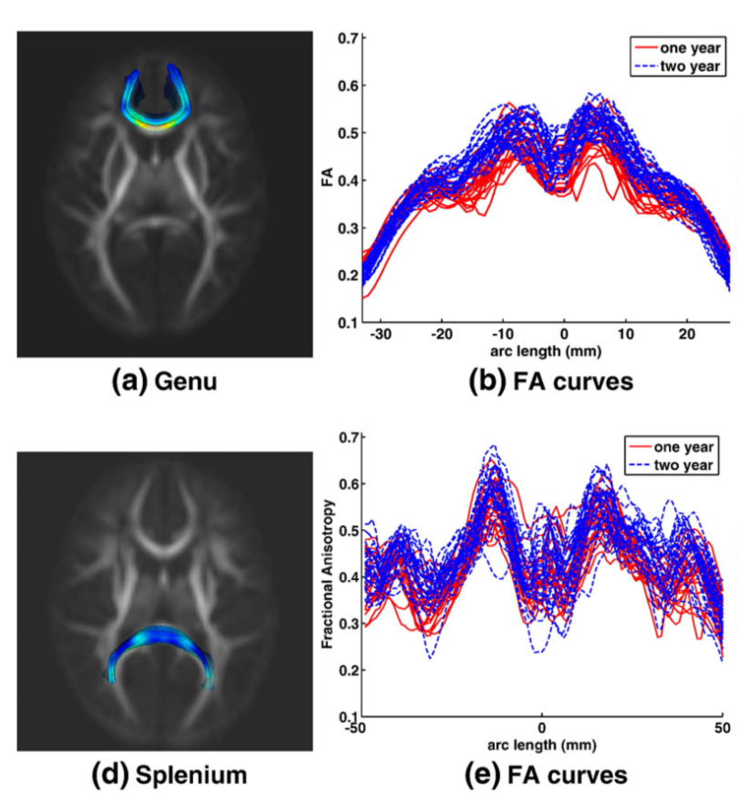
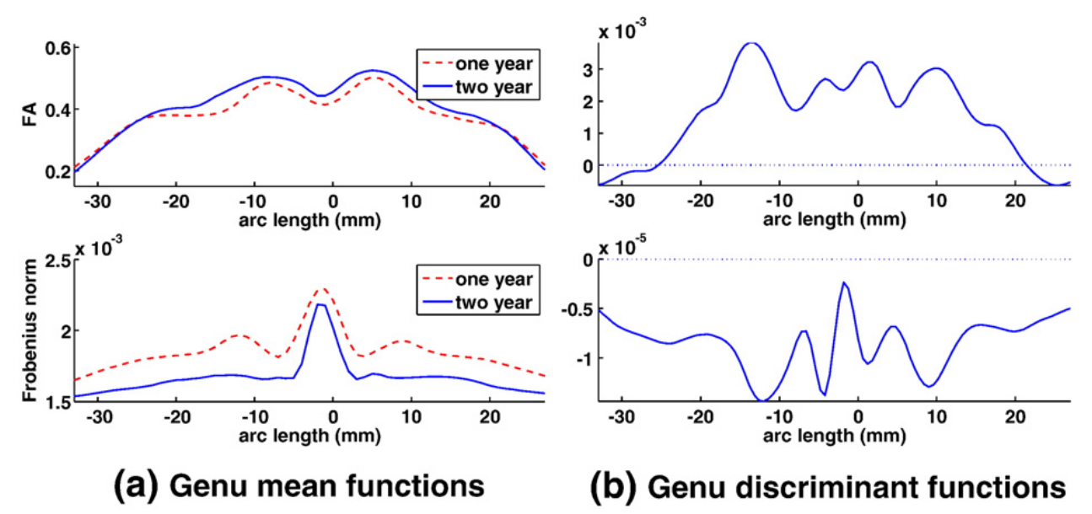
Functional data analysis in tract profiles
Goodlett et al. Neuroimage 2009
As it is difficult to compare directly
the arc length functions:
The authors used functional data analysis
to fit the profiles as coefficients of
B-splines.
And then used discriminant analysis
with the principal components of
the coefficients of these B-splines.
Tract-analysis and connectivity - Eleftherios Garyfallidis (2015)

Slide 30
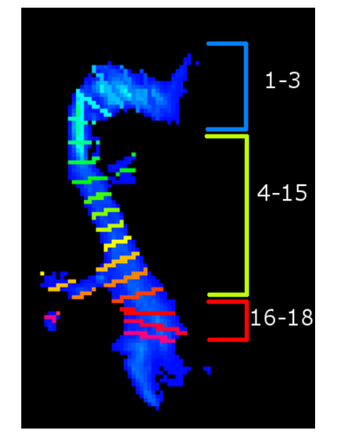
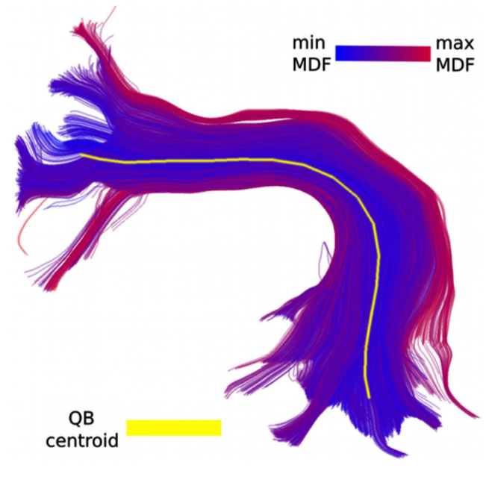
Measures along/from a centroid
Cross-sections along a centroid
Renauld et al., “Morphology of thalamus, LGN and optic radiation do not influence EEG alpha waves”, Brain function and structure (submitted), 2015
Distance maps from centroid
Tract-analysis and connectivity - Eleftherios Garyfallidis (2015)

Slide 31
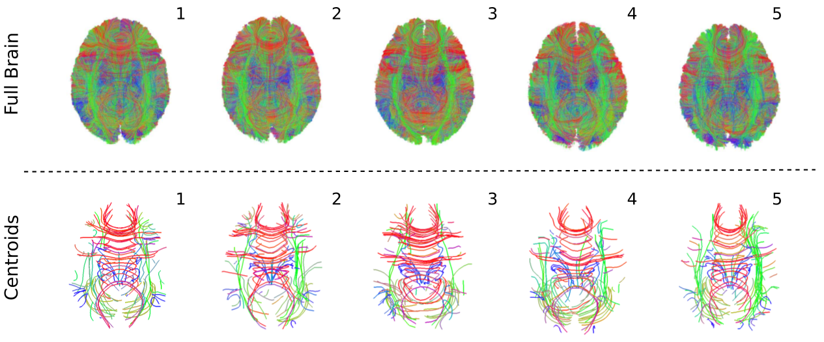
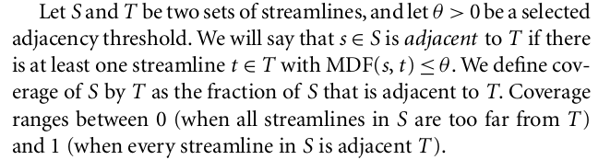
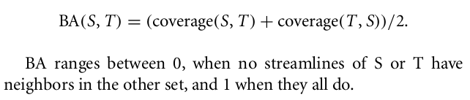
Comparing sets of streamlines for group comparisons (advanced)
Garyfallidis et al. Frontiers, 2012
Bundle adjacency (BA) is a metric
for comparing how similar are
clusters between different subjects.
The streamlines of all subjects need
to be in the same space.
Tract-analysis and connectivity - Eleftherios Garyfallidis (2015)

Slide 32
Conclusion
Make the mental leap from images to streamlines. The grid is not everything!
The world of streamlines is a world of opportunity.
Automatic segmentation of streamlines is reducing manual segmentation.
Registration of bundles is robust to incomplete data.
Clustering/simplification can show you hidden structures and reduce computational complexity.
Study the bundles using centroids, distances, clusters, cross-sections.
Do not stick only to Tensor metrics move to AFD, QA and other newer metrics.
Tract-analysis and connectivity - Eleftherios Garyfallidis (2015)

Slide 33
Conclusion
Be critical about how you measure connectivity.
Make sure you do your pre-processing right.
Think of more robust ways to measure connectivity and
use graph theory.
Combine connectomics with tract-analysis.
Nearly all the methods shown in this course are available in DIPY (http://dipy.org).
Find me in the DIPY exhibition booth for more information.
Tract-analysis and connectivity - Eleftherios Garyfallidis (2015)

Slide 34




Thank you for your attention!
Tract-analysis and connectivity - Eleftherios Garyfallidis (2015)

